Slide 1
Joint Venture in an ICT Solution
Ticketing Solution for Eastern Africa
Providence Development Corporation
20th July 2013

Slide 2
Presentation Overview
Introduction to Wonderkid
The Opportunity in Ticketing Solutions
The Strategy & Business Model
The Requirements
Wonderkid’s Invitation

Slide 3
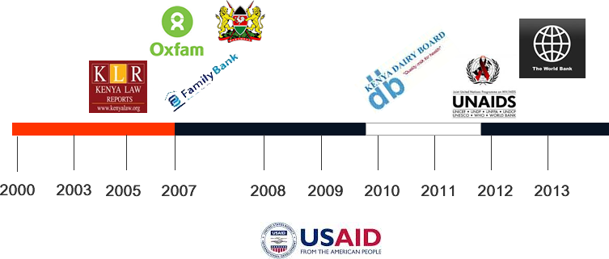
Brief History
About Wonderkid

Slide 4
About Wonderkid
About Wonderkid
At Present, Wonderkid has…
2 Directors (Dickson & Daniel)
No External Debt / Debt Free

Slide 5
Vision & Strategy
About Wonderkid
To provide relevant, affordable, scalable, daily use tech tools for Africa
At Present, Wonderkid has…
Home Grown Enterprise Solutions
Joint Ventures / Partnership Projects
Strategic Partnerships with Governments / NGOs

Slide 6
Joint Ventures & Partnerships
About Wonderkid ~
Why?
Leverage on strengths in partnerships
Foster innovation and specialty in the concerned sector

Slide 7
Opportunity in Commercial Ticketing Solutions
The Opportunity
FACTS
Over 70% access to education
Over 63% mobile penetration in Kenya ( 30,429,351 in Dec 2012 )
Over 70% of Kenyan Population below 30 years old
Convenience of Mobile Money transactions
Internet accessibility via Mobile Phone (9,406,843 Dec 2012 - Up 11% a quarter )

Slide 8
Ticketing Solutions for…
The Opportunity
Events Ticketing
Movies, Shows, Seminars, Plays, Musicals etc
Bus Ticketing
Why ?
There is evidence of opportunity and gap
Both need back-end enterprise solution
Short cycles hence ensuring return usage/ sustainability
Replicable (territory & concept)

Slide 9
The Opportunity
Competition / Leaders
emanamba.com (2008)
ticketsasa.com (2011)
easytravel (2009 by Safaricom)
Travelstart.co.ke (1999 by a Finish / South African Based)

Slide 10
Market is still unexploited…
The Opportunity~
TravelStart has no buses or event tickets
eManamba has only 3 bus companies
Easy Travel no longer operational

Slide 11
What will be different?
The Strategy & Business Model
Minimum Interruption to existing business model “interests”
Adjoin relevant services to increase usage
“Superior” Technology
Minimum entry costs / low entry barriers
Low Costs / High Volume Transactions
Complement – not Compete (?)
Rapid Deployment
Viral Marketing

Slide 12
Business Model for Bus Companies
The Strategy & Business Model
A Fixed Commission for each Ticket Sold Online
No Commission for Tickets Sold at the office UNLESS paid via MPESA
Revenue Share with MNO for customer feedback via SMS
Advertising on courtesy SMSes sent to Travelers
Inclusion / invitation of Insurance Companies

Slide 13
Business Model for Events Tickets
The Strategy & Business Model
A Commission included in the Ticket Price
No Commission for Tickets Sold at the office UNLESS paid via MPESA
Revenue Share with MNO for customer feedback via SMS
Advertising on courtesy SMSes subscribed on platform

Slide 14
Revenue Projections – Bus Companies
The Strategy & Business Model
Coast Bus, Akamba, Nyamira Express, Otange, MASH, Vanga, Simba Coach, Xerox Dreamline, Messina, MAslah, Amani coaches, West Coaches, Horizon, 2nK Sacco, Chania Comfort, Chania Genesis, Parrot line, x Calibur, Eldoret Express, Spanish Coach, Easy Coach, Transline Classic, Kampala Coach, Crown Buses, Modern Coast, MASH, Mbukinya, The Guardian, Kalita Coaches , Palmdam, Transline Msafiri, Transline classic, Premium shuttles, Nyanza shuttle, North Rift, Molo Line, Scandinavian

Slide 15
Cost of Implementation / Fee
The Strategy & Business Model
1) Bus Companies
One-time fee per installation per station to cater for costs
Optional subscriptions for related services
2) Events
Free cloud account (?)
SMS Advertising

Slide 16
Daily Revenue Projections – Bus Companies
The Strategy & Business Model
1) Seat Bookings
50 buses x 45 Seats = 2,250 seats x Ksh. 50 = Ksh. 112,500
2) Feedback SMSes?
3) SMS Advertising Revenue ?
Eg: Dear Daniel, your bus will be leaving at 10:00pm, Accra Road. Incase of anything,call us 0722123123 [Advert: Woolworths Mega Sale 50% Off Countywide]

Slide 17
Daily Revenue Projections – Events
The Strategy & Business Model
1) Seat Bookings
Depends on the Event (?)
2) Events Broadcast SMSes?
3) SMS Advertising Revenue ?

Slide 18
Requirements & Timelines
Requirements~
Stage 1. Development Team (2)
To Finalize on the Alpha Version (4 months )
Stage 2. Marketing / PreSales Team / Account Managers (2)
To (1) Pitch & (2) Get finer business & platform requirements ( From month 2 )
Stage 3. Launch
( From month 6 )

Slide 19
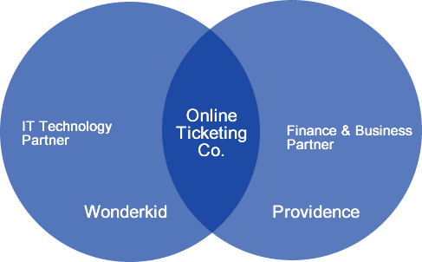
Joint Venture
Requirements~

